Slide 1
A Comparative Measurement Study of Commercial 5G mmWave Deployments
Arvind Narayanan⁺, Muhammad I. Rochman*
Ahmad Hassan⁺, Bariq Firmansyah^, Vanlin Sathya*, Monisha Ghosh*, Feng Qian⁺, Zhi-Li Zhang⁺
⁺University of Minnesota, *University of Chicago, ^Institut Teknologi Bandung
Notes:
Thank you for attending today’s talk on our paper titled “A Comparative measurement Study of Commercial 5G mmWave Deployments”. This paper is mostly a joint work between University of Minnesota and University of Chicago, in which I and Arvind Narayanan are the corresponding authors. In this work we measure and compare 5G mmWave deployments between two commercial operators in Chicago.

Slide 2
Outline
Measurement Tools and Methodology
Overview of Operators and Deployments
Beam Selection Analysis
Performance Analysis
Conclusions
Notes:
Here are the outline of today’s presentation. Firstly, we will discuss measurement tools and methodology
idem to the end

Slide 3
Research Problem Statement
5G New Radio (NR) has been commercially deployed in the United States, one such deployment is mmWave (>24 GHz) which reported to achieve a downlink performance in the Gbps
How can we quantify the performance of commercially deployed 5G mmWave, using PHY, RRC, and application layer information obtained by Commercial-Over-The-Shelf (COTS) devices (5G smartphones)?
Notes:
First we define our problem statement, which is that 5G NR has been commercially and widely deployed in the US
idem
idem

Slide 4
Problem Statement – Previous Works
Recent works have explored the feasibility of mmWave as communication spectrum in theoretical and controlled experiments [Akbar, et al. (2018), Li, et al. (2020), Fernandez, et al. (2021)]
There are also measurements on commercial mmWave deployments using commercial-over-the-shelf (COTS) device (5G smartphone) [Narayanan, et al. (2020), Rochman, et al. (2021)]
Notes:
Recent works have studied mmWave in the theoretical and controlled experiments
But our previous works have studied real world deployment using commercial over the shelf or COTS devices

Slide 5
Problem Statement – Measuring a Real Deployment
There is a need to accurately observe signal parameters in real deployment
RSRP, RB allocation, beam selection, etc.
Measurements on 5G smartphones are currently limited to API that are exposed by the device’s OS, e.g., Android’s Telephony API
We utilized a professional measurement framework, namely Accuver XCAL to uncover “hidden variables” that affect 5G mmWave performance
Notes:
And we identified a need to accurately observe signal parameters of a real deployment
such as RSRP, RB allocation, beam selection, etc
idem
So we utilized a professional idem

Slide 6
Key Contributions
Detailed parameters of commercial mmWave deployments
City-wide coverage analysis of mmWave deployments
Comparison of path loss in different frequencies and environments
Beam selection analysis
Throughput performance analysis
Dataset [https://5gbeams.umn.edu]
Notes:
The key contributions of this paper as follows, first, we revealed details on the parameters of commercial mmWave deployments related to beam selection and its performance
Second, we conducted a city-wide drive test and we are the first to conduct such detailed measurements on a large scope
Third, we demonstrate a signal-strength based method to characterize propagation loss on receive signal power.
fourth, we empirically evaluate the beam selection mechanisms adopted by the operators.
fifth, we proceed to understand the impact of deployment parameters and beam selection on throughput performance
and lastly, we provided this detailed measurement dataset to use for free in the following URL

Slide 7
Measurement Methodology

Slide 8
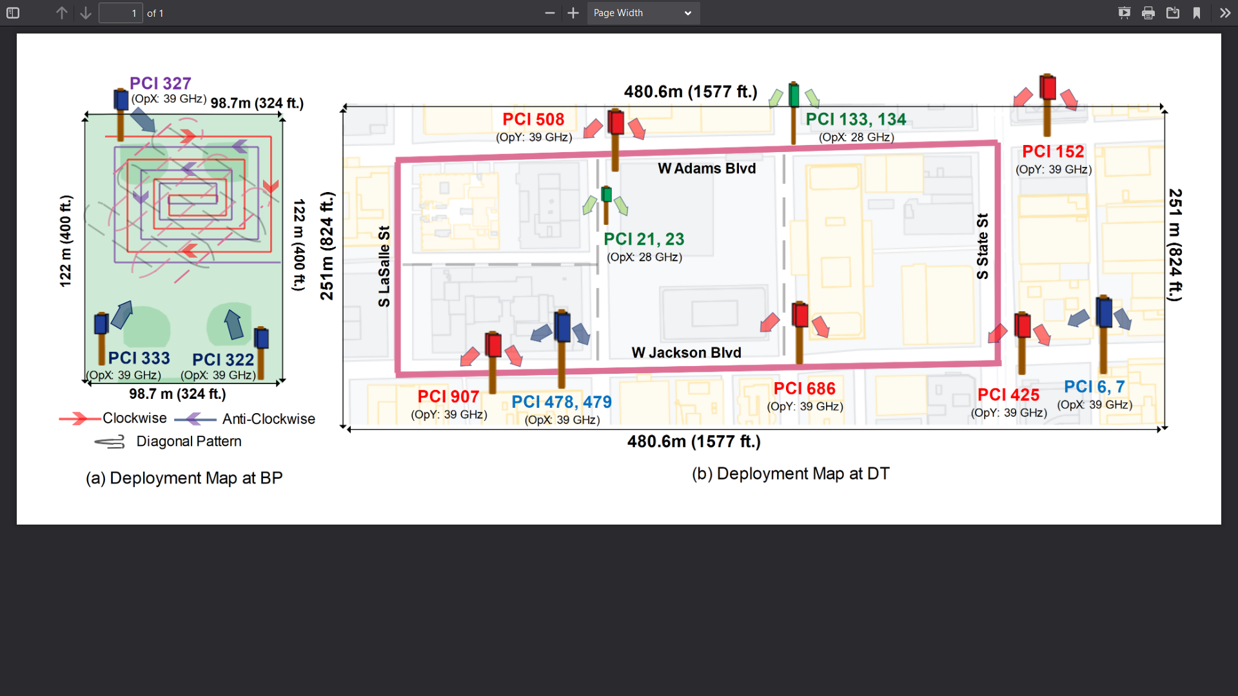
Map of 5G mmWave Deployment with Walking Route
Measurement in June 2021, OpX (Verizon) & OpY (AT&T)
Notes:
We did measurement in June 2021, and there are two operators that deployed mmWave at the measurement area, which are verizon labelled OpX, and AT&T labelled OpY
Here are the maps of our measurement area:
the left is labelled BP, is the upper hutchinson field park which is an open field
and the right is DT or Downtown Chicago, specifically in the Loop area, which is an urban jungle environment with buildings or skyscrapers
The walking routes are shown on these maps:
For BP, we walked on a clockwise, counterclockwise, and two diagonal pattern
For DT, we walked on a counterclockwise route through 3 by 1 blocks of streets
As shown on the map, at BP, we observed three OpX BSs deployed covering the park, all deployed using 39 GHz
While at DT, we observed 4 OpX BSs, 2 BSs on 28 GHz and 2 BSs on 39 GHz
On the other hand, OpY deployed 5 BSs, all on 39 GHz

Slide 9
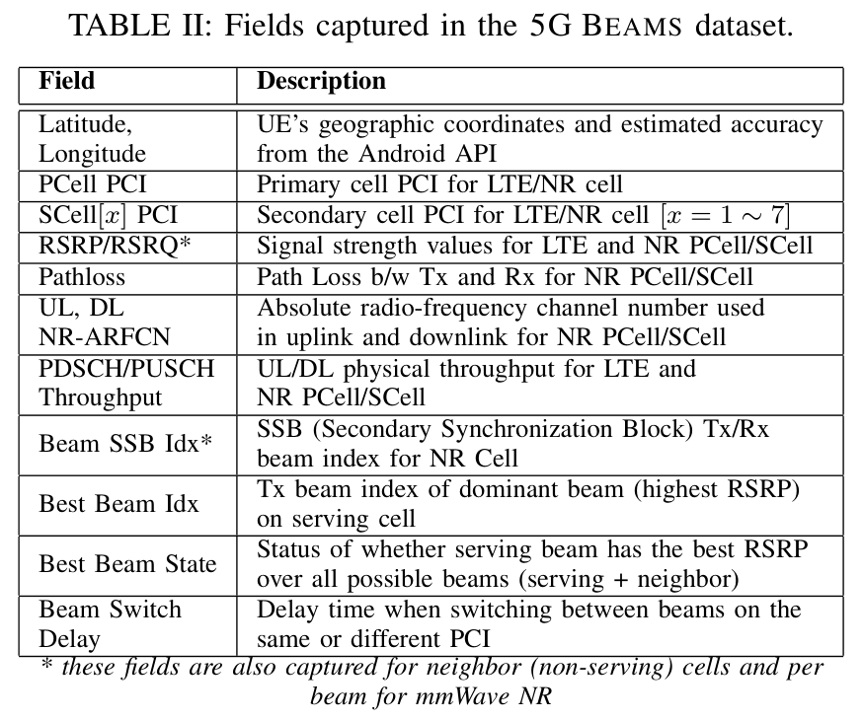
Measurement Tool and Collected Data
Accuver XCAL – Passively collection of data through Qualcomm diagnosis interface
3 × Samsung Galaxy S21 Ultra 5G capable of receiving 5G in low, mid, and high/mmWave bands.
mmWave: 8 Tx beams using 2 Rx beams, utilizing up to 8 × 100 MHz wide channels
Notes:
As previously mentioned, we used Accuver XCAL to passively collects data this tool uses Qualcomm diagnosis interface to extract information that are listed on the table
And for the UE, we use state-of-the-art galaxy s21 ultra, idem

Slide 10
Utilized Traffic
Ping – measures round trip latency to Google DNS server (8.8.8.8)
Helps ensure 4G and 5G radios connection (RRC_CONNECTED state)
Utilized for beam management and coverage analysis
HTTP – continuous download of a large YUV data blob over HTTPS
Utilized to understand the implications of beam management to network performance (e.g., throughput)
Notes:
idem all

Slide 11
5G mmWave Deployments at Chicago

Slide 12
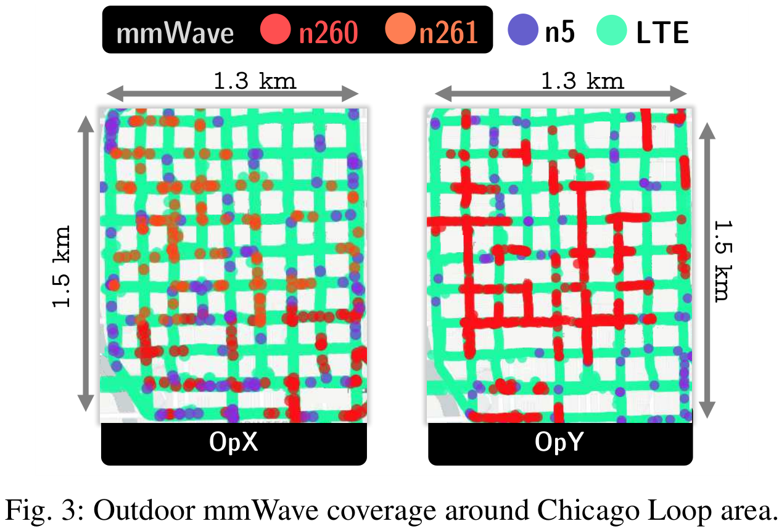
Overview of 5G Deployments in Downtown Chicago
We drove at low-speeds (<25km/hr) through the Chicago Loop area, while measuring with two phones mounted at the windshield
OpX is able to provide mmWave connectivity to the UE for ∼41% of the time during the entire drive session, while OpY provides ∼33%
Maximum combined mmWave coverage is 35%, or 24.1 km out of 69.1 km
Notes:
This is the overview of 5G deployment in Downtown Chicago, idem
idem
OpX is able to provide a more constant mmWave connectivity to the UE
Overall, we calculated a maximum coverage of 35% for both operators combined.

Slide 13
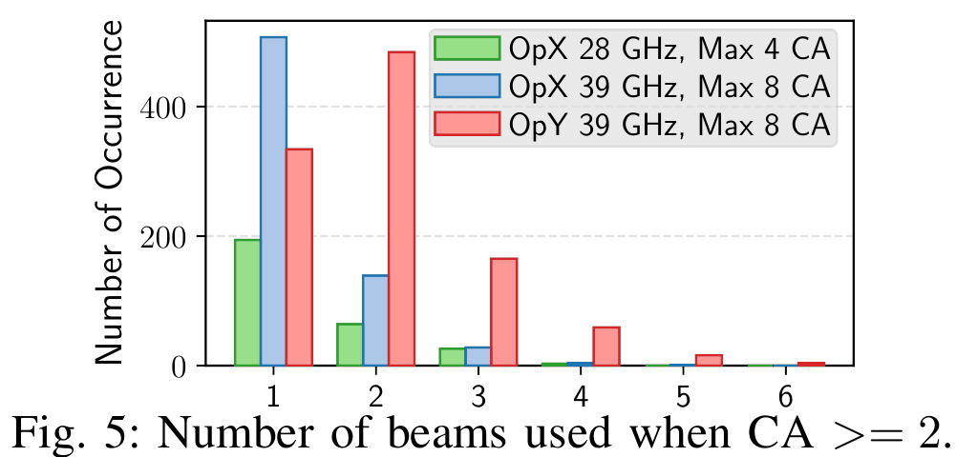
CA and mmWave Beam
When two channels are aggregated, OpX oftenly use a single beam index while OpY mostly uses two different beam indices.
OpY uses more beam indices on compared to OpX (56 vs. 13)
Indicates OpX uses wider beams than OpY.
Notes:
Here is the statistics on number of different beam indices when using two or more channels, we see OpX mostly only use one beam index to aggregate multiple channels, while OpY uses two different beam indices
Additionally, OpY uses 56 beam indices per PCI, while OpX uses only 13
idem

Slide 14
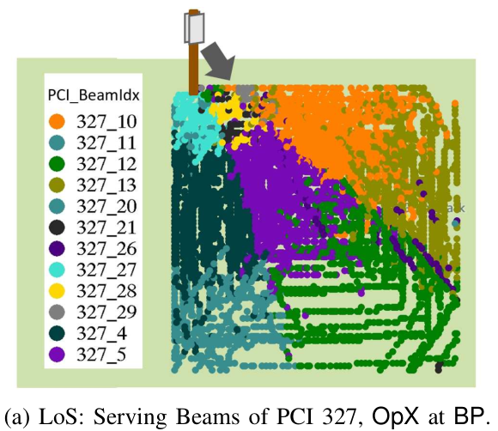
Beam Coverage in LoS Condition
PCI 327 on the figure shows clear demarcation of geographical footprint for each beams index under LoS conditions.
Each unique beam covers an area approximately between 1,800-4,000 m²
Notes:
Here’s the beam coverage in BP, this figure shows the map of beam index on BS with PCI 327, and the figure shows clear demarcation of each beam index under LoS condition
Each unique beam cover a pretty large area

Slide 15
Beam Coverage in NLoS Condition
In the urban environment of DT, there can be both LoS and NLoS connection between BS and UE
PCI 479 at the figure, shows sparse beam coverage unlike the clear footprints observed at BP
Beam coverage both depends on the reflective environment and the position of UE (orientation, speed, etc.)
Notes:
On the other hand for DT, BS and UE can both establish a direct line of sight, or a non line of sight connection due to reflection of building surfaces
For example on the figure is the beam coverage of PCI 479 at DT, we observe a highly dynamic and sparse coverage of each beam unlike the clear footprints observed under LoS conditions in BP.
We observe that beam coverage in this condition highly depends on the reflective environment and the position of UE when measuring the signals

Slide 16
Beam Selection Analysis

Slide 17
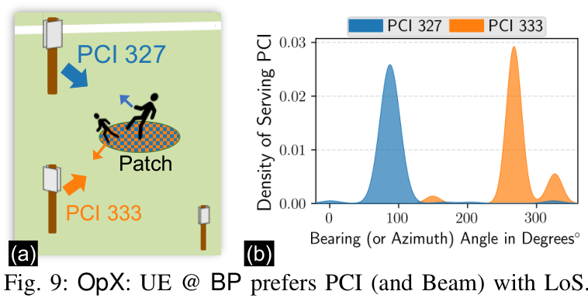
Serving PCI at BP
At BP, UE is connected to the PCI with LoS
Higher probability of connection to PCI 327 when UE facing towards it, and similarly for PCI 333
Notes:
We use data at BP to determine the correlation between orientation and serving PCI.
In the LoS condition of BP, UE is connected mostly to the PCI it is facing towards

Slide 18
Serving, Best, and Neighbor Beam
XCAL collects RSRP of multiple Tx beams, each with label:
Serving beam: current beam that serves the UE
Best beam: beam with highest RSRP, it could be serving beam or other beam in other PCI
Neighbor beam: other received beam that is not serving and best beam, there are up to 3 neighbor beams from highest to lowest RSRP
Notes:
For the next beam analysis, we need to define beam labels assigned by XCAL
idem
idem
idem

Slide 19
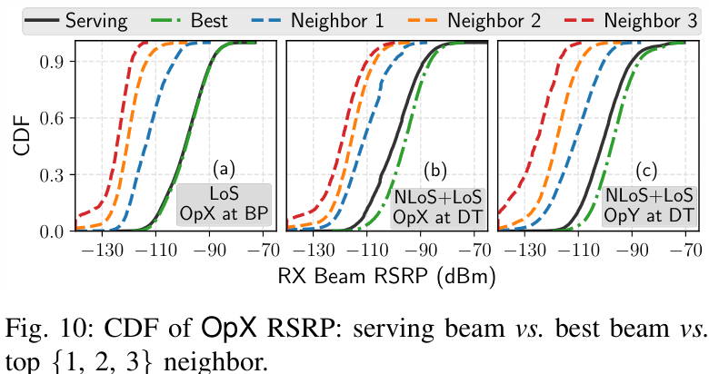
Comparison of Serving, Best, and Neighbor Beams’ RSRP
On BP, serving beam is best beam most of the time
Big gap between serving and neighbor 1 beam (~14.4 dB)
On DT, serving is not the best beam (~3.6 dB lower)
Differences in environmental features has an impact to beam choice
Notes:
Then, we compare serving, best, and neighbor beams’ RSRP for all operators at BP and DT. The first figure which is BP, serving beam is the best beam most of the time
And there is big gap between serving and neighbor 1 beam
While the second and third figure show OpX and OpY at DT. There, the serving beam is not always the best beam.
Clearly, differences in the environmental features has an impact to signal propagation, which in turns impacting the choice of beam.

Slide 20
Beam Switching Statistics at DT
OpY utilized more beam indices but with considerably low delay
Possibly used a more efficient beam management algorithm
Overall, BSs with 39 GHz operation has higher intra-BS switching delay
Inter-BS switching has higher delay and interval due to the distance between BSs
OpX’s 39 GHz BSs are deployed 340 m between each other, UE never switch between them
Notes:
We present beam switching data taken from HTTP traffic at DT. When beam is switching within the same BS, we label this as intra-BS, and between different BS as inter-BS. We present switch interval which is the average interval when switching occurred, and the switching delay or the time needed to switch the beam, for the delay we present the average and standard deviation
idem
which possibly demonstrates a more efficient beam management algorithm
idem
finally, there is a higher delay and interval on inter-BS switching as expected
with the exception of OpX in 39 GHz, which are deployed around 340 m between each other, and the UE never switch between them

Slide 21
Performance Analysis

Slide 22
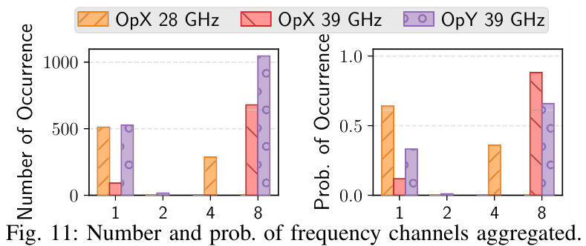
Channel Aggregation on DT
OpX only aggregates a maximum of 4 channels in 28 GHz, while it only uses 1 channel (no aggregation) most of the time
Both OpX and OpY more oftenly aggregates 8 channels in 39 GHz
Notes:
This is the channel aggregation statistics at DT, idem

Slide 23
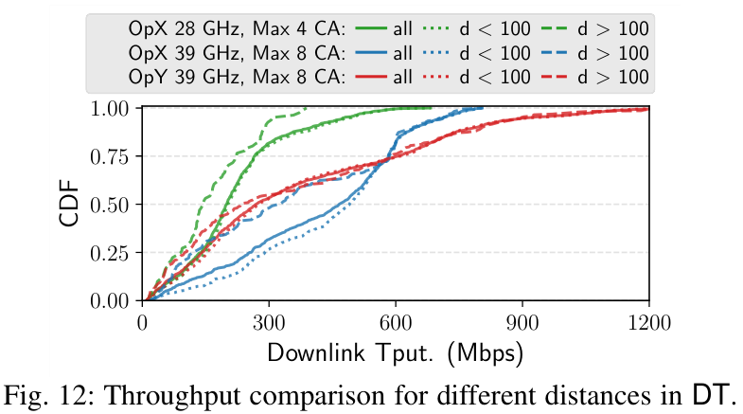
Throughput Comparison at DT
OpX 28 GHz has the lowest maximum throughput due to 4 maximum channel aggregation, and high probability of not using aggregation
OpX 39 GHz has the best median throughput due to higher probability of aggregating 8 channels
However, its median throughput when d > 100 m is lesser, indicating that the increased CA outweigh the reduced RSRP due to distance
Notes:
From channel aggregation statistic, we can discuss the throughput collected on HTTP traffic at DT, here we separate it by operators and bands, and we also presented the all data, and data when d, or distance between BS and UE is < 100 m and > 100m. Idem

Slide 24
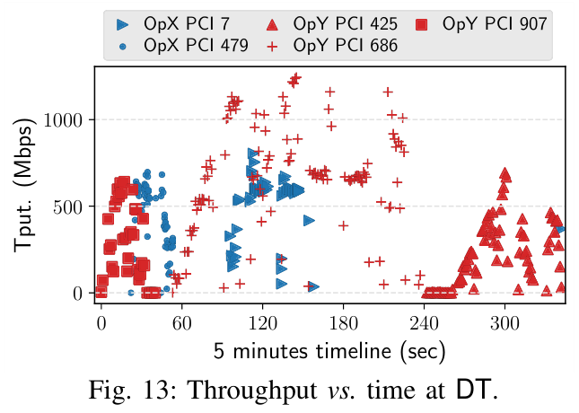
Throughput vs. Time at DT
Throughput on a 5 minutes timeline: walking from LaSalle-Jackson to State-Jackson
Uniform throughput achieved by OpY due to dense (3 BSs) deployment
Notes:
We also present a section of DT measurement in a timeline. Here is the throughput while walking from lasalle-jackson to state-jackson as shown on the map
idem

Slide 25
Congestion Experiment at BP
At BP, we put 3 UEs (S21 phones) at 50 meters to PCI 327
All UEs connected to the same PCI and beam
Utilizing iPerf3 (to 3 different servers in Minnesota and Chicago) to saturate DL mmWave channels (8 parallel TCP connections)
Each phones started iPerf3 session at 1 minute intervals
Varying the start order
Notes:
Lastly, we present a congestion experiment at BP, which we put 3 S21 phones at 50 meters to PCI 327
idem
idem
idem
and we vary the start order

Slide 26
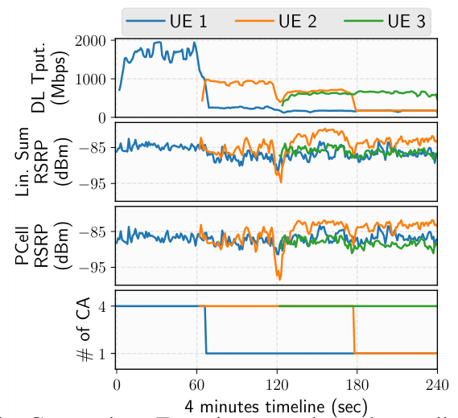
Congestion Experiment at BP
Linear sum RSRP: sum of all mmWave channel RSRP in power domain
We observed a similar trend: priorly started UEs’ throughput are reduced as soon as the next UE starts its traffic
Throughput decrease due to reduction from 4 CA to 1
All UEs used the maximum possible RB allocation, with mostly 64-QAM modulation
Possible throttling decision by either BS or UE
Notes:
This is the throughput, linear sum RSRP, primary RSRP and # of CA in 4 minutes timeline. idem
Over 9 runs, we observed a similar trend: in which priorly started UE’s throughput are reduced after one minute
idem
Meanwhile, all UEs used the maxim possible RB allocation, with mostly 64-QAM modulation
This indicates a throttling decision by either BS or UE, one thing that we did not check at that time is whether thermal throttling has occurred, since after the experiment, we found out that thermal throttling can happen consistently during mmWave transmission with high throughput

Slide 27
Conclusions and Future Works

Slide 28
Conclusion and Future Works
We designed and conducted field experiments in Chicago city involving two major 5G operators using state-of-the-art measurement tools that collect both application layer as well as rich lower-layer information
Difference in mmWave deployment parameters used by the operators (e.g., beam selection, frequency, deployment density) which provide interesting insights on the mmWave coverage
Comparative study to reveal the relative importance of the configuration parameters on beam management, signal propagation characteristics and network performance
Public access to data at https://5gbeams.umn.edu

Slide 29
Thanks for watching!
Any questions?

Slide 30
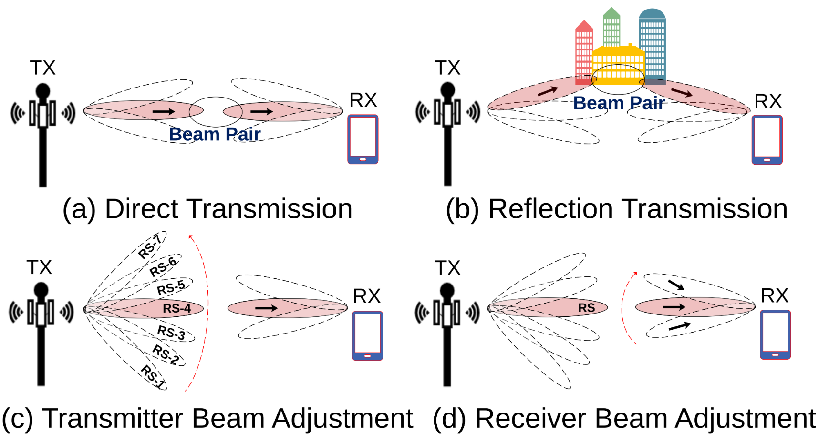
A Bit of Background on 5G mmWave
mmWave signals problems:
Short range due to high frequency attenuation
Doppler shift due to mobility
Shadowing by environment
Mostly, line-of-sight propagation are feasible for real-world communication
Beam-based deployment
Notes:
A little bit background on 5G mmWave. Due to the nature of its high frequency, the mmwave signals are prone to problems such as
idem
idem
idem
Idem
Therefore, to achieve a sustainable connection, the idea is to use multiple focused beams to achieve LoS connection between BS and UE. Additionally, this beam-based deployment can actually exploit the reflection of focused beams to achieve NLoS connection
The figure shows multiple operation modes of mmWave beam. Firstly, both BS and UE can have multiple directed beams to achieve a connection, which are called Tx and Rx beam, respectively. The first figure (a) is a direct LoS transmission between TX and RX beam pair, figure (b) is a NLoS transmission due to beam reflection, figure (c) shows that Tx beam can be adjusted to achieve a better connection to the UE, while figure (d) shows that Rx beam can also similarly adjusted. This adjustment can be analog or digital, which is a topic called beamforming that is not the scope of this work.

Slide 31
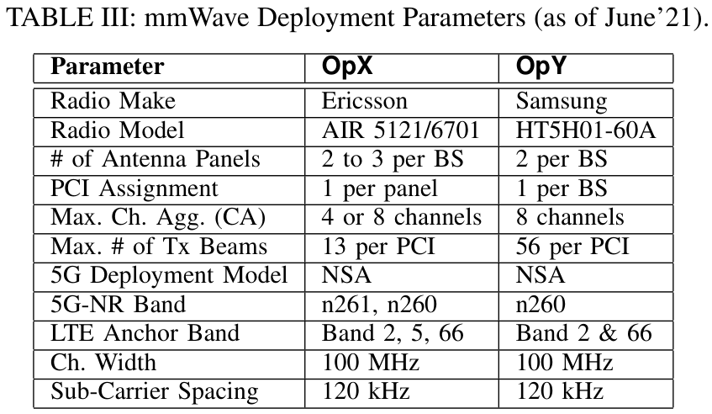
Key Differences in Deployment Parameters
PCI assignment:
OpX: Unique PCI per antenna panel
OpY: One PCI per BS
# of beam indices
OpX: Lower # indicates wider beamwidth
OpY: Higher # indicates narrower beamwidth
5G-NR Bands/Frequencies
Notes:
We were able to identify the radio make and model of the mmWave BS, and there are key differences in deployment parameters between these two operators.
First is the PCI assignment where OpX uses unique PCI per antenna panel, which means there can be up to 2 to 3 unique PCI per BS since there are 2 or 3 antenna panels per BS.
On the other hand, OpY uses one unique PCI per BS.
There is also difference in the number of beam indices,
OpX with 13 beams per PCI which indicates wider beam width,
and in the opposite OpY with 56 beams per PCI indicating narrower beamwidth
Interestingly, the highest beam index we observed is 29 and 63, for opx and opy respectively, indicating that there are beam index that were not captured due to being inactive or might be observed in higher altitude
OpX uses band n261, which is 28 GHz, and n260 which is 39 GHz, while OpY only uses n260

Slide 32
Comparison of Downtown Maps
The purple rectangles indicates the 3x1 blocks of measurement area
Notes:
Here is the comparison to the full Loop area map to the DT area map. the purple squares indicates the 3 by 1 blocks where we focused our measurements

Slide 33
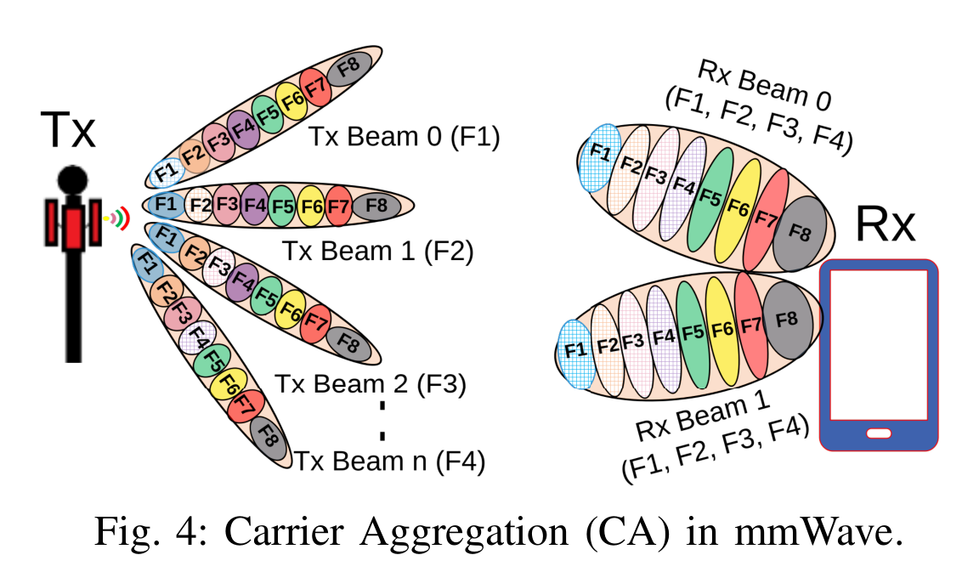
Carrier Aggregation (CA) in Commercial mmWave
CA in frequency occurs over a single beam or multiple beams
A single beam transmits in a same set of frequencies
UE picks the best Tx Beams over a set of frequency, receiving using all of its Rx Beams simultaneously
This is unlike a pure implementation of Multiple-Input-Multiple-Output (MIMO) where BS transmit the same signal over multiple frequencies, but an aggregation of different signals over space-frequency with receive combining
Notes:
idem
For example on the figure, Tx Beam 0 to n carries the same set of 8 frequencies. In the figure, the CA decision is to aggregate F1 to F4 on UE
UE picks to receive F1 from Tx Beam 0, F2 from Tx Beam 1, and so on, and they are all received on UE’s Rx Beam 0 and 1 simultaneously
Therefore, this is unlike a pure implementation of Multiple-Input-Multiple-Output (MIMO) where BS transmit the same signal over multiple frequencies, but this is an aggregation of different signals over space-frequency with receive combining, since for instance, F1 at Tx Beam 1 can be simultaneously used to transmit different data to another UE

Slide 34
Propagation Analysis

Slide 35
Methodology and Limitations
Measurement data collected using Ping traffic in BP and DT
All S21 phones using OpX and OpY
Average RSRP value (in power domain) sensed at the two Rx beams
Distance between device and BS calculated from GPS location
While RSRP values are not calibrated, we use the same phone models and modem chipset
XCAL collects “path loss” measurement, however it is not clear how it is being computed since Tx power could vary
GPS location inaccuracies due to tall buildings in DT
Notes:
idem all

Slide 36
Methodology and Limitations
We use a floating intercept model for relative comparison of RSRP values:
where
d: distance in meters
α: intercept in dB
β: slope
Xσ: zero mean Gaussian random variable with standard deviation σ in dB
Notes:
Since RSRP is well defined in the specification, we relatively compare RSRP values using floating intercept model which is a well known pathloss model

Slide 37
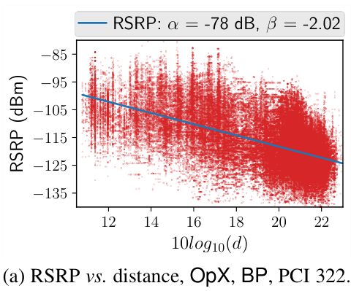
RSRP vs. Distance for OpX in BP
Best linear fit line computed from all Tx-Rx beam pair RSRP
β should not be considered as the path-loss exponent (PLE)
Reference power at 1 m α includes all contributions due to frequency dependence, Tx and Rx antenna gains, clutter, body loss, foliage, etc.
β can be used to make relative comparisons between deployments

Slide 38
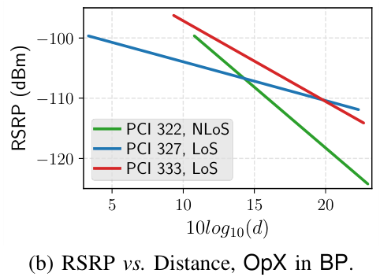
RSRP vs. Distance for OpX in BP
Although BP is an open field, PCI 322 shows higher β slope due to slightly covered by foliage (NLoS) in some area
PCI 322 shows a possible higher pathloss compared to other PCI

Slide 39
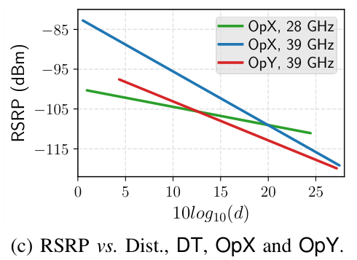
RSRP vs. Distance for OpX and OpY in DT
OpX at 28 GHz has a lower lower β slope compared to 39 GHz, due to the frequency difference
OpX at 39 GHz exhibits a slightly higher β slope compared to OpY, possibly due to wider Tx beam leading to less power received at the same distance
Overall no significant difference at 39 GHz

